Slide 1
Environment Orientation
Ben Church

Slide 2
Social Behavior
The topic drew me to:
Environment orientation: a structured simulation approach for agent-based complex systems [Hoverd and Stepney 2014]
Communication based dynamic role allocation in a group of homogeneous robots [Gigliotta et al. 2014]
A cognitive-inspired algorithm for growing networks [Massaro et al. 2014]

Slide 3
Hoverd and Stepney 2014
Environment orientation: a structured simulation approach for agent-based complex systems

Slide 4
Environment orientation (EO)
Simulation paradigm
Based on object oriented simulation
Objects interact through their environment
Contrast to direct agent-agent message passing

Slide 5
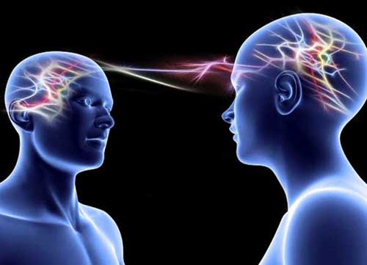
Direct communication
Straightforward existing approach
Can result in deadlock
Acyclic graphs and barrier synchronization unnatural
Computationally expensive – O(n²)
Unnatural – action-at-a-distance
Agent 1
Agent 2
Waiting for
Waiting for
Waiting for
Agent 3
http://www.crystalinks.com/telepathy500a.jpg

Slide 6
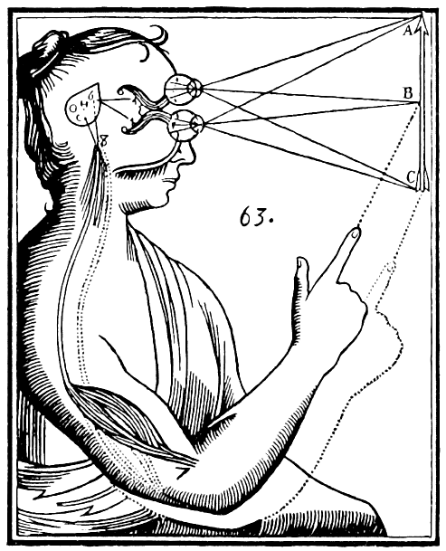

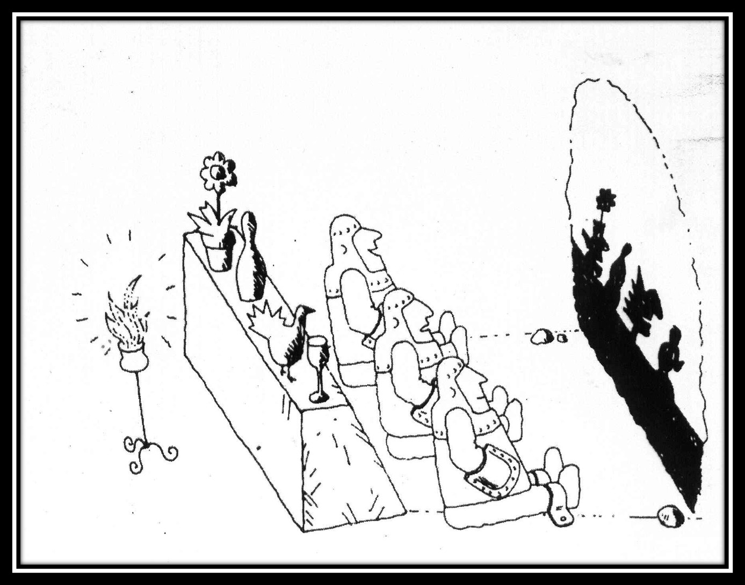

Natural inspiration
Agents present external states to environment
Environment mediates information propagation
Agents read environment state
Agents update internal state
http://pad3.whstatic.com/images/thumb/3/3f/Make-Shadow-Puppets-Step-06.jpg/aid1153554-728px-Make-Shadow-Puppets-Step-06.jpg
https://i1.wp.com/fc02.deviantart.net/fs70/f/2010/132/a/2/Gears_are_Turning_by_rstovall.gif
https://chairmanmeowmeow.files.wordpress.com/2013/08/platocave.jpg
https://3rdeyevisionblog.files.wordpress.com/2013/01/descartes_mind_and_body2.gif

Slide 7
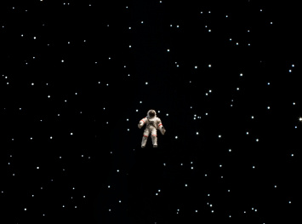



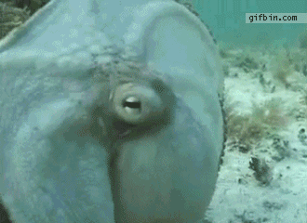
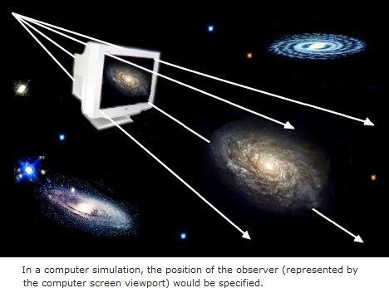
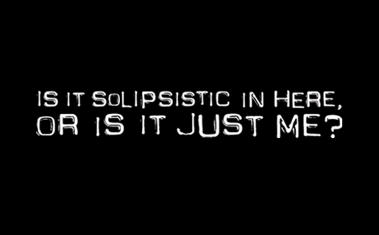
EO definition
Agents have internal state, self-knowledge
Some of internal state is publicized
Behavior depends on internal state, informed by environment
Agents can retrieve other external states
Environment mediates perception
Environment itself is a computation object with own state and behavior
https://s-media-cache-ak0.pinimg.com/originals/3e/14/9f/3e149f646e5677a672ff322420c76e32.gif
http://www.seodirect.org/wp-content/uploads/2012/07/social_media-940x600.jpg
chelseacsuite.com/wp-content/uploads/2014/04/self-awareness.jpg
http://res.cloudinary.com/dk-find-out/image/upload/q_80,w_1440/A-dreamstime_xxl_23971088_qlym7s.jpg
https://images.duckduckgo.com/iu/?u=http%3A%2F%2Fwww.faculty.umb.edu%2Fgary_zabel%2FCourses%2FParallel%2520Universes%2FTexts%2FSimulated%2520Reality%2520The%2520Big%2520Brother%2520Universe_files%2Freality_viewport.jpg&f=1
http://cache4.asset-cache.net/gc/158781036-astronaut-floating-in-space-gettyimages.jpg?v=1&c=IWSAsset&k=2&d=jFqQBwTGo9N%2fTid87dqDZj%2fjNqsG4QkLsQNXqYnRSrk%3d
https://redpillpushers.files.wordpress.com/2014/09/solipsistic-in-here.gif

Slide 8
Claims
EO suitable for producing emergent behavior
Simulation extensible to multiple environments
Simulation can represent physical world

Slide 9
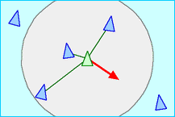
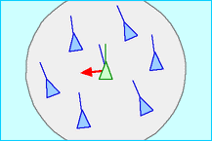
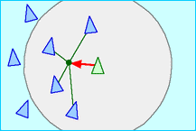
Emergent behavior
Reynold’s boids used to investigate claims
Separation
http://www.red3d.com/cwr/boids/images/separation.gif
Alignment
Cohesion
http://www.red3d.com/cwr/boids/images/alignment.gif
http://www.red3d.com/cwr/boids/images/cohesion.gif

Slide 10
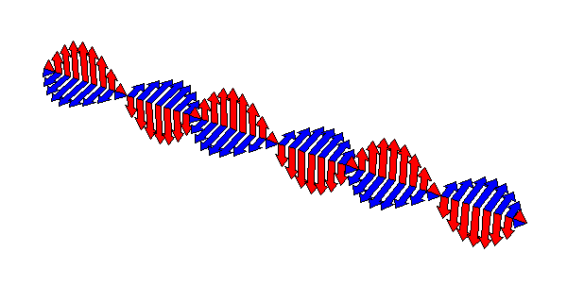

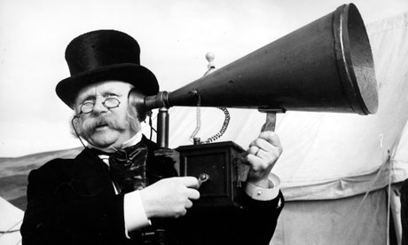

Multiple environments
Agents receive “auditory” species information
Multiple individuals per species, species per trial
Larger species, better flocking
http://4.bp.blogspot.com/-JJfFnkXDlbo/TofLBcymscI/AAAAAAAACEI/BW3yK2zmPd0/s1600/2009-05-28_eye-of-horus.jpg
http://2.bp.blogspot.com/-UShGhxWXhkg/T5Z8eA-QidI/AAAAAAAAAY0/HisFGl4mgIQ/s1600/wave_anim_1_.gif
https://thebunkhousechronicle.files.wordpress.com/2014/10/ear-trumpet.jpg
https://www.lovethisgif.com/uploaded_images/819-sound-wave.gif

Slide 11
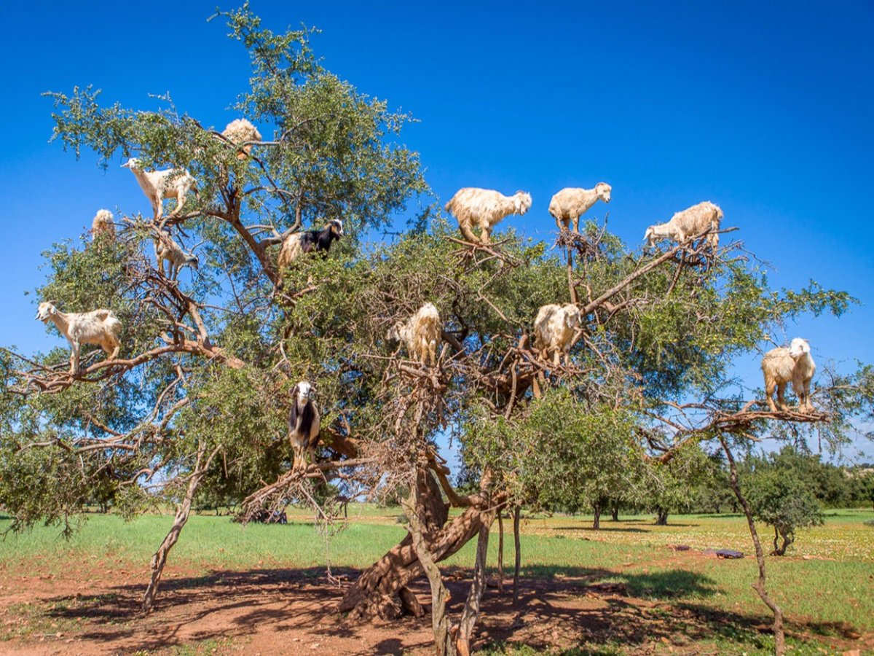
Physical world
Use boids to solve hill climbing
Environment extended to represent landscape
Examined % agents above 90% global maximum
https://static-ssl.businessinsider.com/image/55a95e92371d2210008b771c-1200/goats-in-tree.jpg

Slide 12
Results
Emergent flocking behavior
Improved flocking with range parameter
Improved flocking with individuals per species
Search space convergence
Improved with range parameter
Improved with individuals per species

Slide 13
Critique
Cons:
Inappropriate choice of metrics
No comparison to status quo method
Pros:
Widely applicable
Conceptually rich

Slide 14
Thank you!
Questions?

